Slide 1
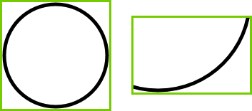


$$A$$
$$\vec{p}$$
m_vTopLeft
m_vBottomRt

Slide 2









$$\vec{u}=[u_{x},u_{y}]$$
$$\vec{p}=[p_{x},p_{y}]$$
$$\vec{v}=[v_{x},v_{y}]$$
$$[a_{l},a_{t}]$$
$$A$$
$$[b_{l},b_{t}]$$
$$B$$
$$[a_{r},a_{b}]$$
$$[b_{r},b_{b}]$$

